Slide 1
Revealing the Secrets Behind Essential Skills
A Magical Presentation by Cody Clark

Slide 2
Self Management
Definition: Ability to consistently complete personal tasks
Self Management Need to Knows:
What you want/need to do
How you plan on doing it
Your timeline
Accountability/Rewards

Slide 3
Real Time Goal Breakdown
Goal/Desired End Result: Help mom w/ groceries
What Do You Need?: Groceries, a trip to the grocery store, you and your mom’s assistance
Steps:
Make trip to grocery store. Help mom in grocery as needed
Drive home
Unlock trunk door
Divide and conquer
Bring groceries in house
Make return trips and repeat as needed
Close trunk
In home, put groceries
Dispose of bags
Reward: Eat snacks you purchased with groceries!

Slide 4
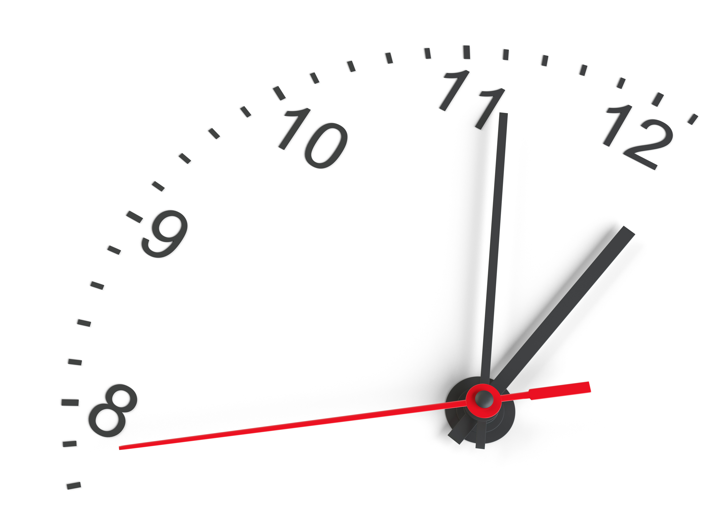
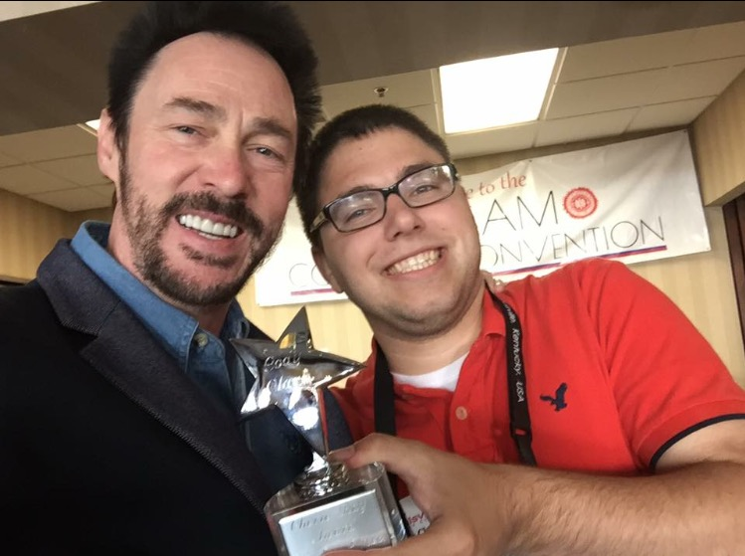
Goal Accountabilty
Definition: Steps taken to make sure goals are met
Examples:
Reminder alarms/calendars
Your boss/paycheck
Caregivers, friends, teachers, parents
Rewards

Slide 5
People Management
Definition: Relating well with other people
Key Social Skills:
Active listening
“What do you think?”
Be assertive about your ideas/feelings, yet open minded to any result

Slide 6
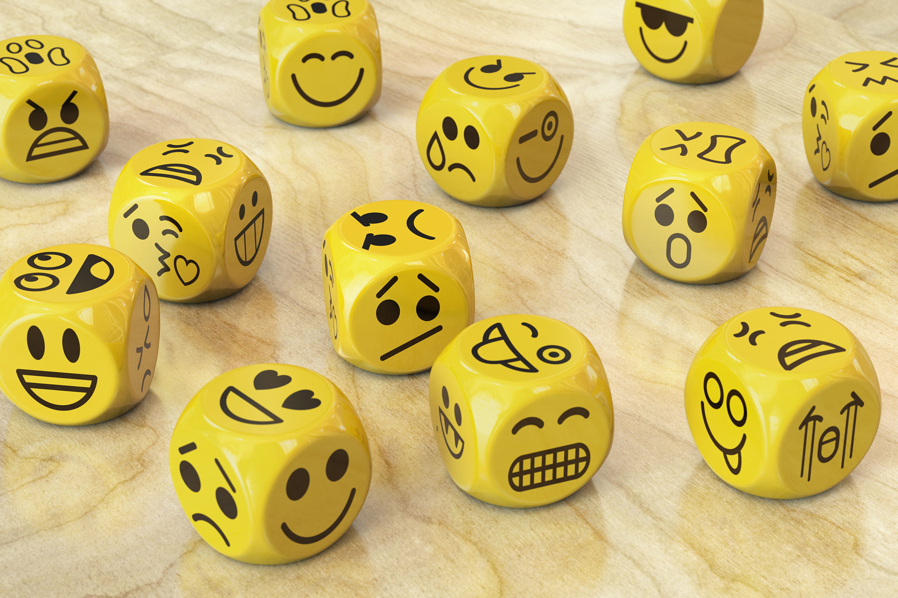
Emotional Management
Definition: Handling emotions, both with other people and yourself
Scary because there’s so many emotions!
Plus social pressure to be happy 100% of the time

Slide 7
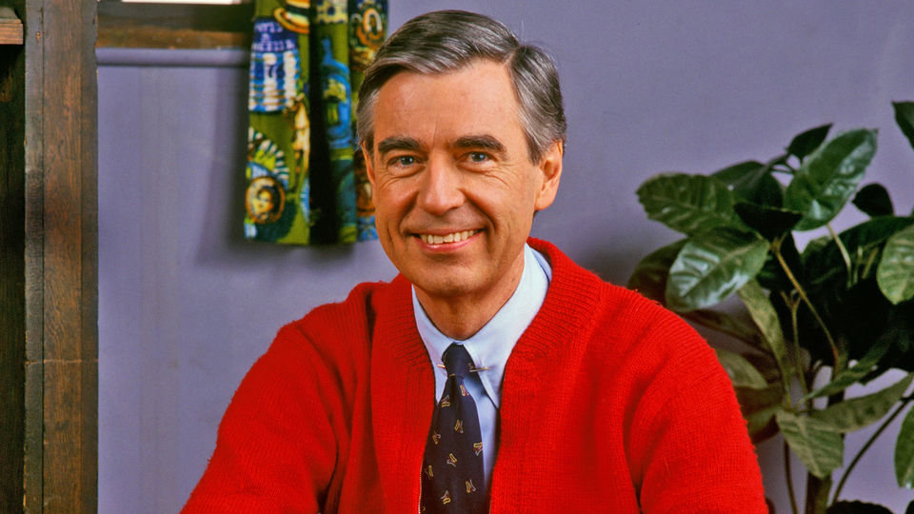
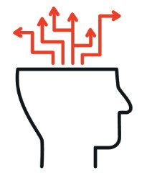
Emotional Management
Definition: Handling life’s many feelings
Mr. Rogers - “It’s okay to be sad or mad…..as long as you handle it in a way that doesn’t harm others”
Key is to accept, yet address negative emotions,
1. Safely experience emotions
2. Look at facts
3. Consider ALL outcomes
4. Make basic action plans
5. Act on preferred, knowing you have options
This Photo by Unknown Author is licensed under CC BY-NC-ND
This Photo by Unknown Author is licensed under CC BY-SA

Slide 8
Emotion Management - Others
Use words for context clues
Example: sad/mad words = sadness, laughs usually come from jokes, positive words = happiness
A person’s availability also gives clues
Open door/quick replies = good mood
Closed doors/slow replies = they need space
Don’t take that personal

Slide 9
Benefits of Emotional Management
Clear, peaceful mind
Better able to practice self management
Can keep calm in people management situations too

Slide 10
Conclusion
Thank you for listening!

