Slide 1
Daily Detox:
Practical Strategies for Stress and Burnout Prevention in Helping Professions
Sa’Mya Jones, M.S., NCC

Slide 2
Introduction
Sa’Mya Jones, M.S., NCC
Counselor | Wellness Educator | Speaker
Experience in college counseling, career development, and violence prevention
Former Registered Behavior Technician (RBT), supporting young adults in vocational skill-building through clinic-based businesses
Passionate about making mental wellness accessible, especially for students, professionals, and helping roles
Sometimes experiences burnout

Slide 3
Objectives
Understand
How burnout manifests in diverse ways across individuals, roles, and environments within helping professions.
Examine
How reactive self-care differs from proactive burnout prevention in both intention and impact.
Explore
The Daily Detox model and discover ways to tailor it to individual needs and work styles.
Engage
In hands-on exercises to create a personalized wellness check-in routine that supports daily balance.

Slide 4
What does PTO stand for?

Slide 5
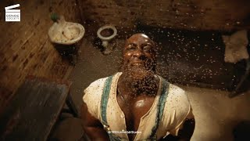
Green Mile
https://youtu.be/K4_RpN8lR78?si=oYEOG1LzQ7edI5mz

Slide 6
What is Burnout?

Slide 7
What is Burnout?
Definition: Burnout is defined as a syndrome conceptualized as resulting from chronic workplace stress that has not been successfully managed.
It is characterized by three dimensions:
Feelings of energy depletion or exhaustion
Increased mental distance from one’s job, feelings of negativity and cynicism related to one's job
Reduced professional efficacy

Slide 8
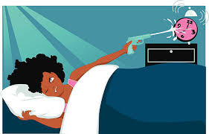
Literature
The Burnout Alarm Was Sounded in the 1970s
Risk identified in “people professions” — helping, healing, and educating roles
Freudenberger (1974, 1975) called it “a state of emotional exhaustion”
It’s Not Just Workload — It’s Life Balance
Researchers urged focus on job-life fit vs. just cutting hours
Maslach (1982), MacBride (1983), Riordan & Seltzer (1992)
We Knew This... But We Still Normalize It
Calls for better support and boundaries go back decades

Slide 9
How are we here in 2025?

Slide 10
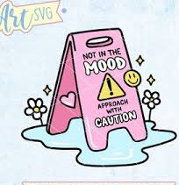
Burnout Warning Signs
Emotional Exhaustion:
Leads to fatigue, headaches, detachment
Negative Attitudes:
Withdrawal from colleagues and clients
Avoidance Behaviors:
Frequent absences, leaving early, extended breaks
Impact on Team Morale:
Creates resentment among coworkers

Slide 11
Let’s talk about it. . .
What are some signs of burnout you’ve noticed in yourself or your coworkers — even if no one said it out loud?
How did it show up physically?
What kind of language did you start using more?
What did you stop doing that used to bring you joy at work?

Slide 12
What’s in your cup?

Slide 13
PHYSICAL WELLNESS
Includes elements such as exercise, nutrition, sleep, and regular check-ups.
MENTAL WELLNESS
Incorporates aspects like stress management, cognitive activities, mindfulness, and relaxation.
Holistic Wellness
EMOTIONAL WELLNESS
Highlights self-awareness, emotional regulation, resilience, and seeking support when needed.
SOCIAL WELLNESS
Represents relationships, social support, community involvement, and effective communication.

Slide 14
Daily Self-Care: Boosting Wellness at Work
Setting Boundaries (Show, Don’t Tell)
Use Your Vacation Time
Advocate for Your Needs
Mindfulness
Self-Check-Ins
Remember Your Why
Talk to Your Support System
Realistic Goal Setting
Improved Communications
Knowing Your Capacity

Slide 15
Now… What’s in your cup?

Slide 16
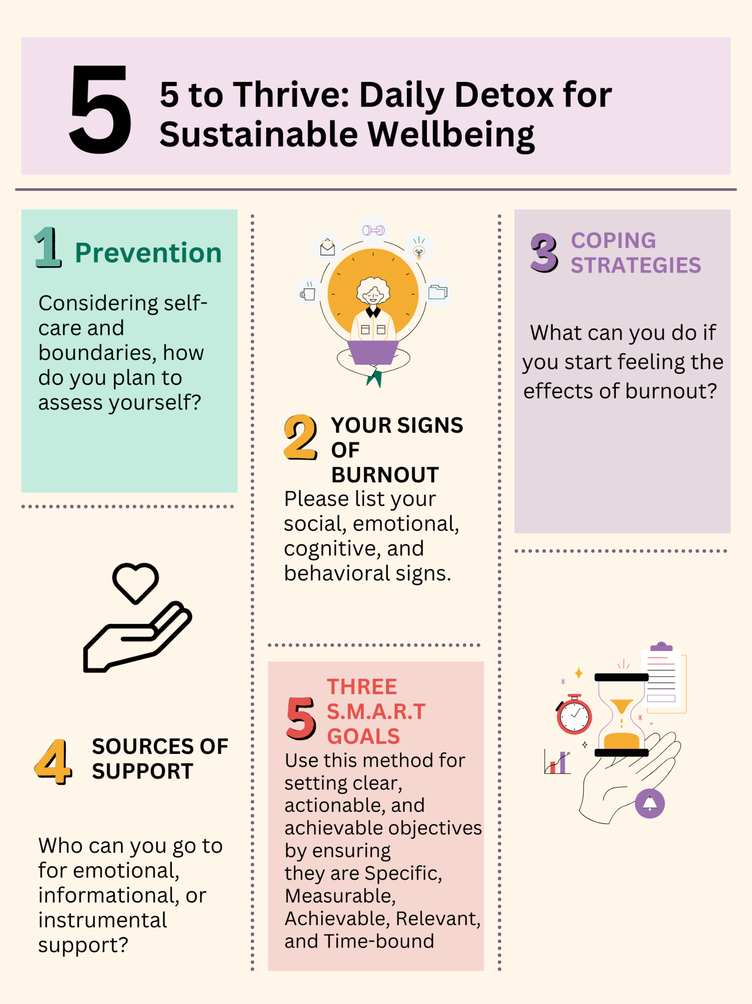
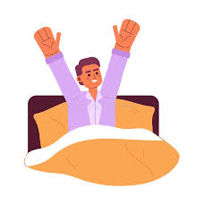
Daily Detox
Understand, Examine, Explore, Engage

Slide 17
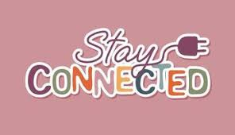
Connect With Me. . .
Sa’Mya Jones:
sajones@shc.edu
LinkedIn: in/samyajones

