Slide 1
IPS Supported Employment
MYTHBUSTERS

Slide 2
Myth Busters Agenda
Let’s break myths about employment

Slide 4
Myth Buster’s Team

Slide 5
Why Focus on Employment
Viewed as an essential part of recovery
Most consumers want to work
A typical role for adults in our society
Alternative to day treatment
2/3 of clients live in poverty; employment in may be a way out
Source: IPS Employment Center
Notes:
70% of people with mental health issues report a strong desire to work.
IPS Supported Employment can help 60-70% of those individuals to become competitively employed.
Once employed, those individuals generally work in regular working hours, report satisfaction with their jobs, and benefit in many other ways from employment.
Employment Status in FY14
Adults: 70,206
Full Time Employed 6.52%
Part Time Employed 3.89%
Unemployed but looking for work 18.03%
Homemaker 2.03%
Student 5.95%
Retired 3.59%
Disabled 43.74%
Inmate 0.76%
Not looking (past 30 days) 15.15%
Supported Employment 0.26%
Not Available 0.08%

Slide 6
Employment’s role in recovery
WHY FOCUS ON EMPLOYMENT

Slide 7
National and State Drivers
Wyatt/Olmstead Litigation
Substance Abuse & Mental Health Service Administration (SAMHSA)Strategic Initiatives
Consumer Voice

Slide 8
Recovery Support Services Important in Alabama
“While consumers have many different goals for recovery, the two most recognized goals are having a home to call their own and a meaningful, stable job.”
Consumer Driven Recovery Focused Mental Health System: A Consumer Perspective, The Alabama Directions Council, 2007, p 5.

Slide 9
Let’s talk about employment

Slide 10
What are some of the benefits from working?

Slide 11
The Value of Work: Work Enhances Recovery
Wellness
Financial – Satisfaction with current and future financial situations
Occupational – Personal satisfaction and enrichment derived from one’s work
Physical – Recognizing the need for physical activity, sleep, and nutrition
Emotional – Develop skills and strategies to cope with stress
Spiritual – Search for meaning and purpose in the human experience
Environmental – Good health by occupying pleasant, stimulating environments that support well-being
Social – Developing a sense of connection and a well-developed support system
Intellectual – Recognizing creative abilities and finding ways to expand knowledge and skills

Slide 12
Dimensions that Support Recovery
Work is strongly linked to health, purpose, and community.
Community
Home
Health
Purpose
Notes:
SAMHSA Mental Health Block Grant
Certified Peer Specialists
Drop In Centers
Warm Line
Certification Training for Certified Peer Specialists
Trainings by Consumer/Family State Advocacy Groups
In Our Own Voice
LIFT
AYM
Family Basics
Vet to Vet
NAMI Connections
Family Education

Slide 14
Negative Effects of Unemployment Increased substance abuse Increased physical problems Increased psychiatric disorders Reduced self esteem Loss of social contacts Alienation and apathy

Slide 15
What role does employment play in recovery?

Slide 16
Recovery?
“My life has enough meaning now that I have a psychiatrist, medications, and a case manager. Why would I mess that up with work?”

Slide 17
Recovery?
“I want to work. Working is what people do. Recovery means mental illness is not the center of my world.”

Slide 18
Individual Placement and Support
Supported Employment

Slide 19
What distinguishes IPS Supported Employment?
Evidence based Practice
28 Random Controlled Trials
Established community of practice – International Learning Community
Research show individuals with a Serious Mental Illness diagnosis are more likely to obtain employment and retain employment when working with an IPS team.

Slide 20
More Evidence in favor of IPS
[S]tudies show IPS participants gained employment faster, maintained employment four times longer during follow-up, earned three times the amount from employment, and were three times as likely to work 20 hours or more per week (https://ipsworks.org/index.php/evidence-for-ips/).

Slide 21
The IPS Supported Employment Learning Community
Facts & Figures
26 US States
4 Counties/Jurisdictions
7 Countries
18.665 served in the US Learning Community states
339 US programs reporting this quarter in the IPS Learning Community

Slide 22
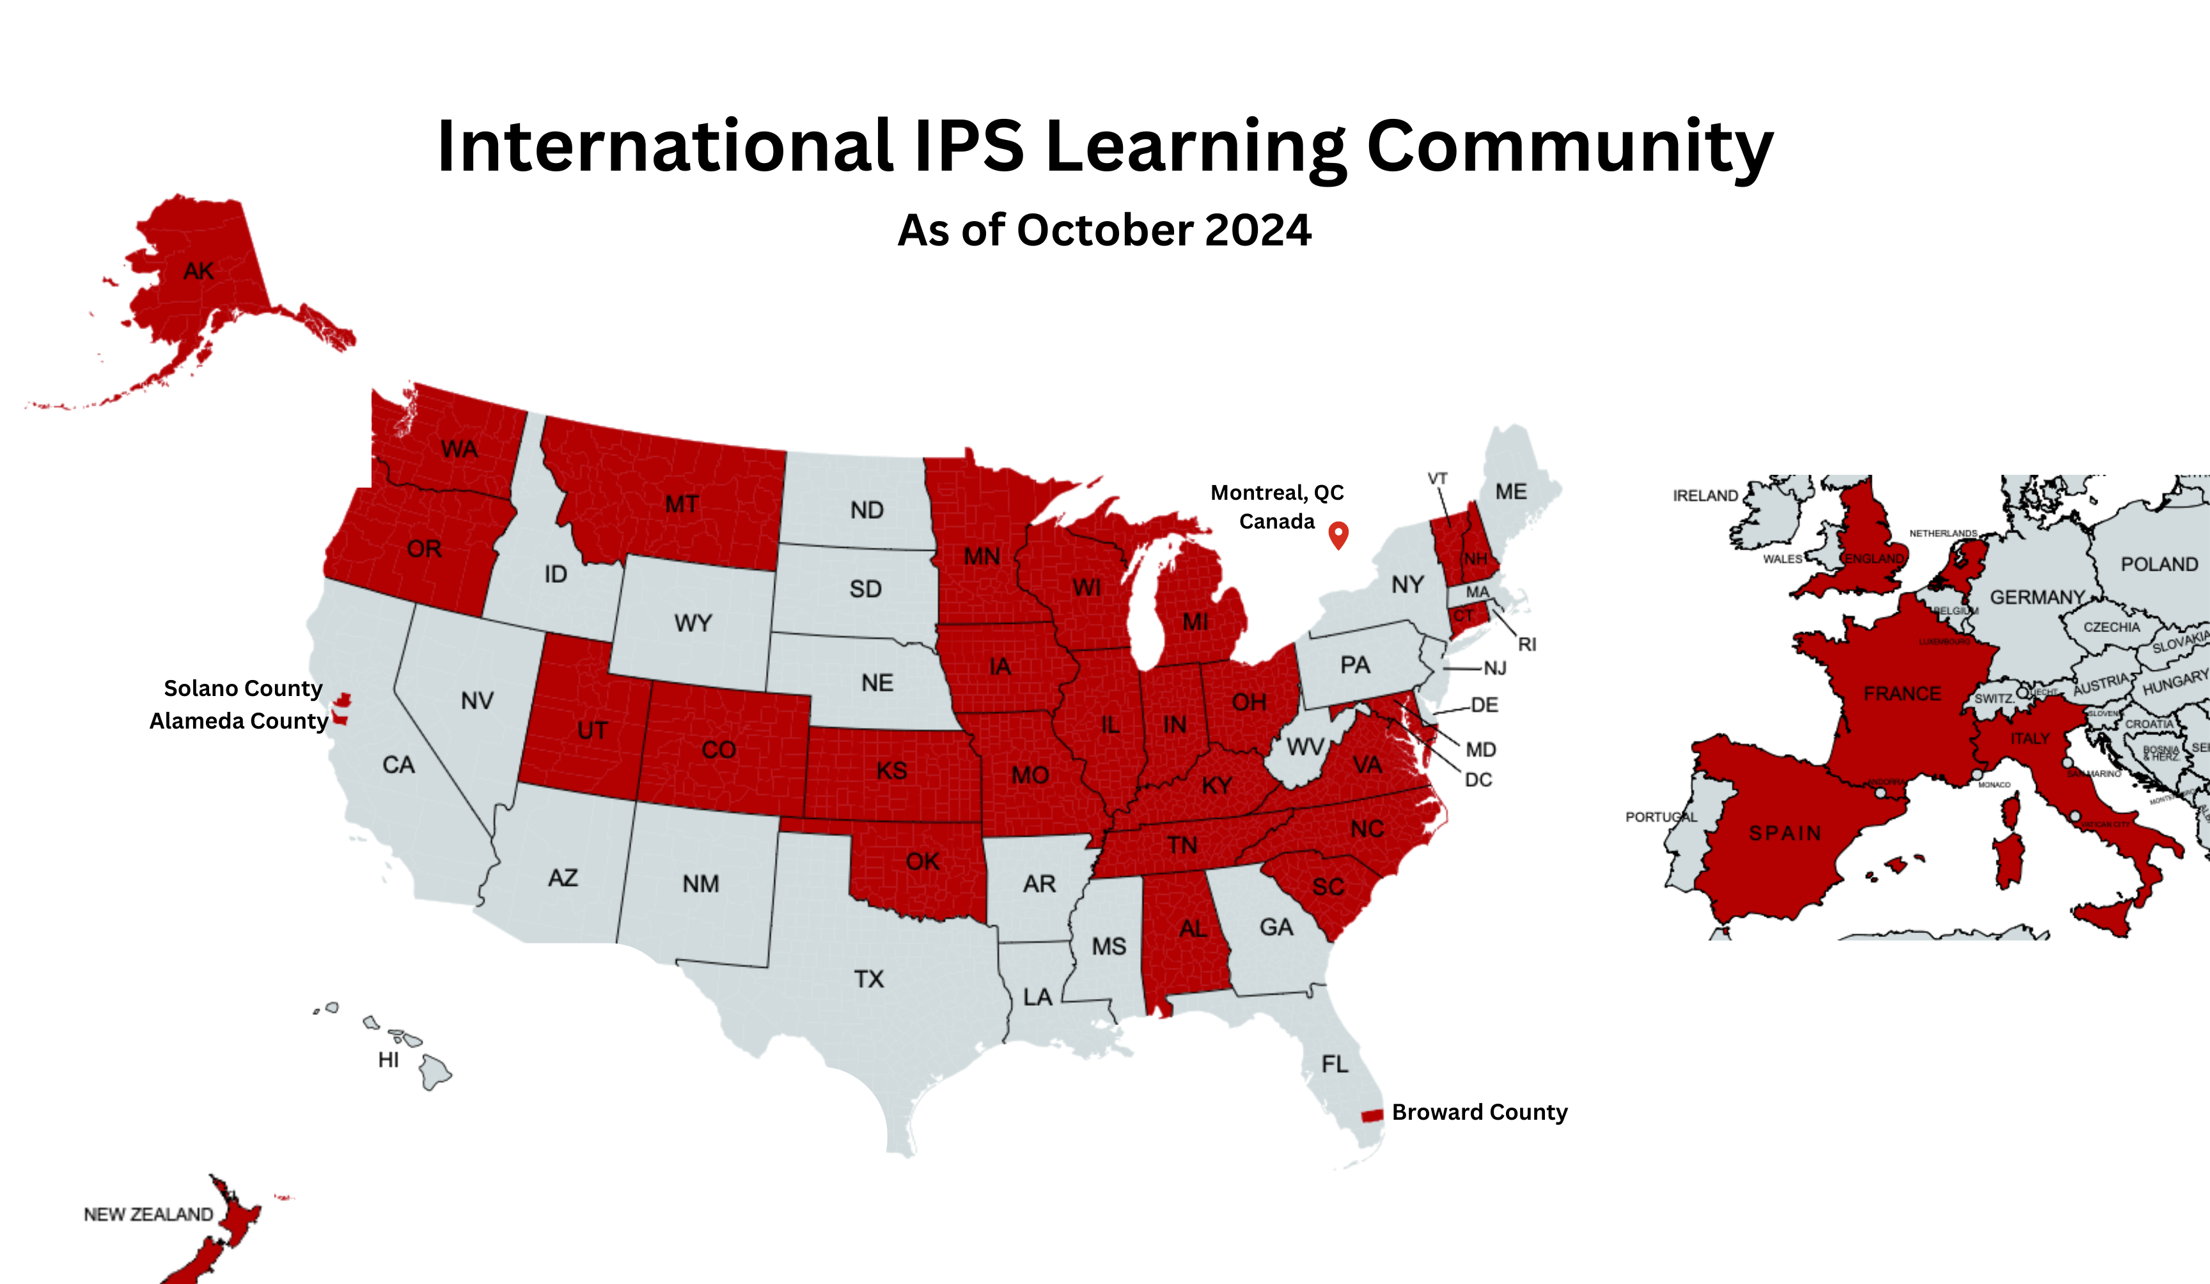
IPS
International Learning Community

Slide 23
What are some of the myths that surround the idea of working?

Slide 24
MYTH OR FACT? I must be symptom free before I consider employment.

Slide 25
MYTH!
IPS PRACTICES ZERO EXCLUSION
CLIENTS ARE NOT EXCLUDED FROM THE PROGRAM ON THE BASIS OF READINESS, SYMPTOMS, SUBSTANCE USE HISTORY, OR ANY OTHER BARRIER.

Slide 26
I will lose my benefits If I work
MYTH or
FACT?

Slide 27
I WILL lose my benefits if I work
MYTH!

Slide 28
The IPS Team includes a certified benefits Specialist
Certified Benefits Specialists help individuals obtain personalized, understandable, and accurate information about their Social Security, Medicaid, and other government entitlements.

Slide 29
MYTH OR FACT
IPS JOB SEEKERS HAVE TO COMPLETE READINESS OR SKILLS PROGRAMS BEFORE THE JOB SEARCH BEGINS

Slide 30
Myth
IPS programs use a rapid job search approach to help job seekers begin their employment journey quickly.

Slide 31
Myth or Fact?
IPS DOES NOT CONSIDER THE CONSUMER’S PREFERENCE WHEN JOB DEVELOPING.

Slide 32
MYTH
THE FACT IS: SERVICES ARE BASED ON EACH PERSON’S PREFERENCES AND CHOICES RATHER THAN THE PROVIDER’S JUDGEMENT.

Slide 33
EMPLOYMENT SPECIALISTS HONOR JOB SEEKER’S EMPLOYMENT PREFERENCES WHEN JOB DEVELOPING

Slide 34
MYTH OR FACT?
EMPLOMENT SPECIALISTS DEVELOP RELATIONSHIPS WITH EMPLOYERS IN THE COMMUNITY. THEY ARE ABLE TO LEARN ABOUT BUSINESS NEEDS AND HIRING PREFERENCES, SO THEY CAN QUICKLY PLACE A JOB SEEKER IN A WORK SETTING OF HIS OR HER PREFERENCE.

Slide 35
TRUE!
IPS Employment Specialists build employer relationships using the “Three Cups of Tea” method. Over time they maintain the relationships with hiring sources within the community by visiting on a regular basis. This employer development philosophy is unique to the IPS model.

Slide 36
IPS Team of Myth busters
Antwoinette Ware, Certified Peer Specialist, AltaPointe Health
Charles Haslerig, Certified Peer Specialist, Carastar Health
Myth Buster and Respect Initiative Speaker
Myth Buster and Respect Initiative Speaker

Slide 37
Myth Buster Success StorIES
Respect Initiative Speakers

Slide 38
AN IPS Mythbuster

Slide 39
Yes you can work

Slide 40
Eight practice principles of IPS supported employment

Slide 41
Eight Principles of IPS Supported Employment
Rapid job search is encouraged
Employment specialists build employer relationships
Follow-along supports are continuous
Consumer preferences are important
Eligibility is based on consumer choice
Competitive employment is the goal
Supported employment is integrated with treatment
Personalized benefits planning is provided
Notes:
REVIEW the 8 PRINCIPLES of IPS
-Open to anyone who wants to work (MOTIVATION- is the greatest prediction to work)
EVERYONE can work with the right supports
Find a CHANGE the CULTURE , Not necessarily natural in mental health
-Focus on Competitive Emp- Wage is the same; NO TIME LIMITS imposed on the program
-Integrated TEAM Members- Treatment teams might include nurses, therapists, psychiatrists.
(VR Counselors may also participate)
-Benefits Planning- impt to address the fear of losing benefits and how to utilize work incentives to full advantage; requires specialty training
-Rapid search- TRIAL WORK are not required (TO BE CLEAR: this is NOT rapid job placement),
job contacts within with in 30 days.
VR counselors are involved early in the process and regularly-will have more knowledge of incoming referrals
Job Development- IMPORTANT TO Know AND Understand the specific Business Needs of potential Employers.
Emp. Specialist- Required to make and track contacts (3 teas)
Long Term Supports- Range from encouragement, asking for accommodations, learning bus route, interpersonal skill, building natural supports- with a goal to work as independently as possible
Client Preferences considered: this will ensure higher chance of job retention
It is an evidence-based practice.
Practitioners focus on each person’s strengths. This is a strengths-based perspective.
Work promotes recovery and wellness.
Practitioners work in collaboration with state vocational rehabilitation counselors.
IPS uses a multidisciplinary team approach. Integration is a key component of IPS.
Services are individualized and long lasting.
The IPS approach changes the way mental health services are delivered.
Swanson, S. J., & Becker, D. R. (2013). IPS supported employment: a practical guide. Lebanon, NH: Dartmouth Psychiatric Research Center.
Bond, G. R. (1998). Principles of the Individual Placement and Support model: Empirical support. Psychiatric Rehabilitation Journal, 22(1), 11-23.
Drake, R. E., Bond, G. R., & Becker, D. R. (2012). Individual Placement and Support: An evidence-based approach to supported employment. New York: Oxford University Press.

Slide 42
Clinical Services can support the Employment Journey
How often do therapists ask about your desire to work?

Slide 43
What would be your dream job?

Slide 44
IPS Programs in Alabama
AltaPointe Health, Mobile, Alabama
Carastar Health, Montgomery, Alabama
Central Alabama Wellness, Chilton and Shelby Counties, Alabama
Indian Rivers, Tuscaloosa, Alabama
Jefferson, Blount, St. Claire (J.B.S.) Western Birmingham, Alabama

Slide 45
The importance of partnership adMH * adrs
IPS SUPPORTED EMPLOYMENT PARTNERS WITH THE ALABAMA DEPARTMENT OF REHABILITATION SERVICES.

Slide 46
Alabama Department of Rehabilitation Services
Alabama Department of Mental Health

Slide 47
Contact Information
Alabama Department of Mental Health
Denise Bern, IPS Trainer/Coordinator
Phone: (334) 353-0006
Email: Denise.bern@mh.alabama.gov
Jessica Hales, Coordinator for Adult MI Services
Phone: (334) 242-3229
Email: Jessica.hales@mh.Alabama.gov
https://mh.alabama.gov/individual-placement-and-support/

