Slide 1

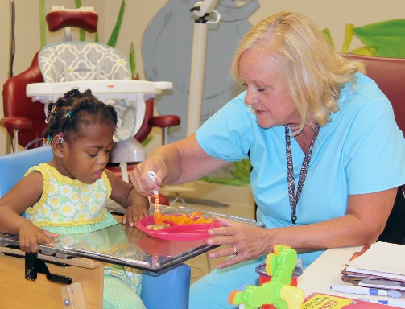
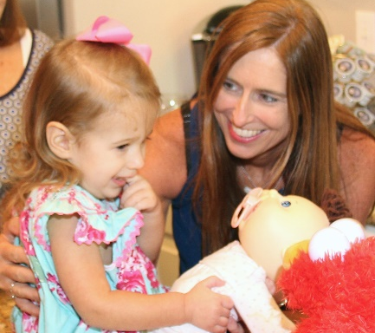
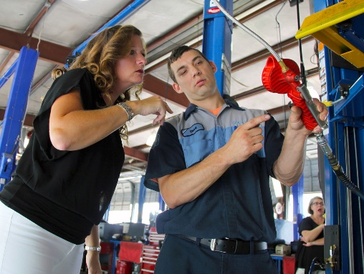
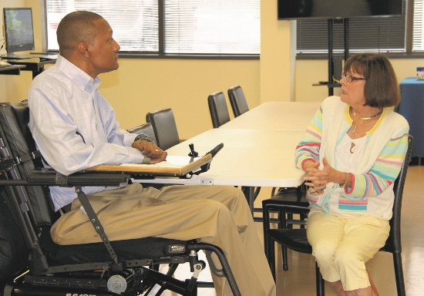
ALABAMA DEPARTMENT OF REHABILITATION SERVICES
Our mission is to enable Alabama's children and adults with disabilities to achieve their maximum potential

Slide 2
Agenda
Who is the READI-Net/Business Relations Program (BRC)?
Request Process/Form
List of Job Readiness Classes
Job Readiness Class Demonstration
Suggestive Skillset for Job Readiness Instructor
Comments/Questions

Slide 3
















RECRUITING
& HIRING
TECHNICAL ASSISTANCE
INNOVATIVE IDEAS ON ACCESSIBILITY
INCLUSIVE WORKPLACE
DISABILITY TRAINING
JOB RETENTION
Pre-Hire Work Experience
Work-Based Learning
Apprenticeships
On-the-job training
Wage Reimbursements
Tax Incentives
Workplace Consultation
Disability management
ADA Resources
503 Compliance
We consult directly with your
business to assist you with finding the right solutions for workplace accommodations
We offer disability and workplace training at no-cost to Alabama's business and industry
We offer return-to-work/
stay-at-work services for employees affected by disability, injury, or illness
Services and solutions that our program provides to Business and Industry

Slide 4
Request Process
BRC email List of Job Readiness Topics to Transition Vocational Rehabilitation (VR) Counselor
Transition Vocational Rehabilitation (VR) Counselor and Special Education Teacher decide on what topic they would like the BRC to present on
Transition VR Counselor communicates with the BRC about topic, suggested date(s), time(s), location, and approximately how many students will be present
Logistics are confirmed

Slide 5
Sample Copy of BRC Request Form
  BRC Pre-Employment Services
  Request Form
  Alabama Department of Rehab Services
Name of High School: ____________________________ VR Counselor: _________________________
Class Contact: ______________________________Email Address:_______________________________
Class Requested: ________________________ Requested Block/s: __________________________
Preferred days of the week for outside presentations:_____________________________________
Please list the students that will be participating in this service:
Student’s Name Grade Educational Pathway
1.
2.
3.

Slide 6
List of Job Readiness Classes
Enthusiasm & Attitude
Mock Interviews
Resume Tips
Problem Solving
Character & Leadership
Workplace Ethics and Behaviors
Disability Etiquette
Job Application Tips
Business Relationships
Importance of a Handshake/First Impressions
Disclosure of Disability
Interview Question Do’s & Don’ts
Dress for Success/Hygiene
Financial Literacy
Employability Skills
How to Take Online Assessments
Interviewing Skills

Slide 7

Oh Be Careful...What You Do!

Slide 8


Demonstration: Non-Verbal Communication Presentation

Slide 9
Suggested Skillset for Job Readiness Instructor
Passion/Love for Youth
Creative
Flexible
Energetic
Engaging
Silly
Must be open to learning as well as teaching
Transparent about personal experiences
Knowledge of how to use the Internet to search for topics and relevant activities for high school students
Being mindful of type of students (i.e. culture, race, and etc)
LOVES TO HAVE FUN!!

Slide 10
Feedback/Comments
Suggestions?
Ideas?
Thoughts?

Slide 11


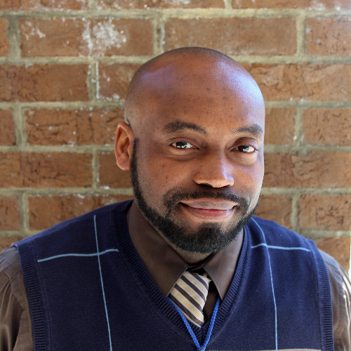





Daniel Spencer
Business Relations Consultant
256-549-7792 – Office
256-390-9130 – Work Cell
Daniel.Spencer@rehab.alabama.gov
Cherokee, Dekalb, Etowah, Marshall, St. Clair
Huntsville, Madison, Scottsboro
1100 George Wallace Drive
Gadsden, AL 35903
https://www.linkedin.com/in/daniel-spencer-17a882b6/

