Slide 1
“Mindfulness, meditation, and essential oils, oH my!”
Using integrative therapies for self-care

Slide 2
Two types of stress
Good Stress (eustress)
Bad stress (distress)
Job promotion
marriage
Buying a new home/ relocating
Having a baby
Winning a prize
graduation
Getting fired
divorce
Bankruptcy
Death of loved one
Natural disaster
illness

Slide 3
Guess what…
Your body cannot tell the difference between distress (bad stress), and eustress (good stress). Although a little stress is good for us…Both types of stress can cause damage to the body if left unchecked or untreated.
According to the American Medical Association, 85% of physical symptoms are derived from unresolved emotional issues (Mercola.com)
When we are under stress: Our brain’s emotional center is deemed “non-essential” and shuts down…down goes your problem solving, executive functioning, creativity, and intuition (The tapping solution.com)

Slide 4
The amygdala
Is Part of The Limbic system which controls:
Emotion
Behavior
Motivation
Long-term memory
Olfaction
It processes fear and anxiety and “fight or flight”
It produces cortisol under stress

Slide 5
The key is to recognize the symptoms of stress before they turn into long term problems such as hypertension, diabetes, stroke, obesity.
Symptoms of stress:
Behavioral changes-sleep disturbance, change in eating habits
Mood disturbances-easily irritated, emotional, closed off
irrational thinking-fear that is not rational, excessive worry

Slide 6
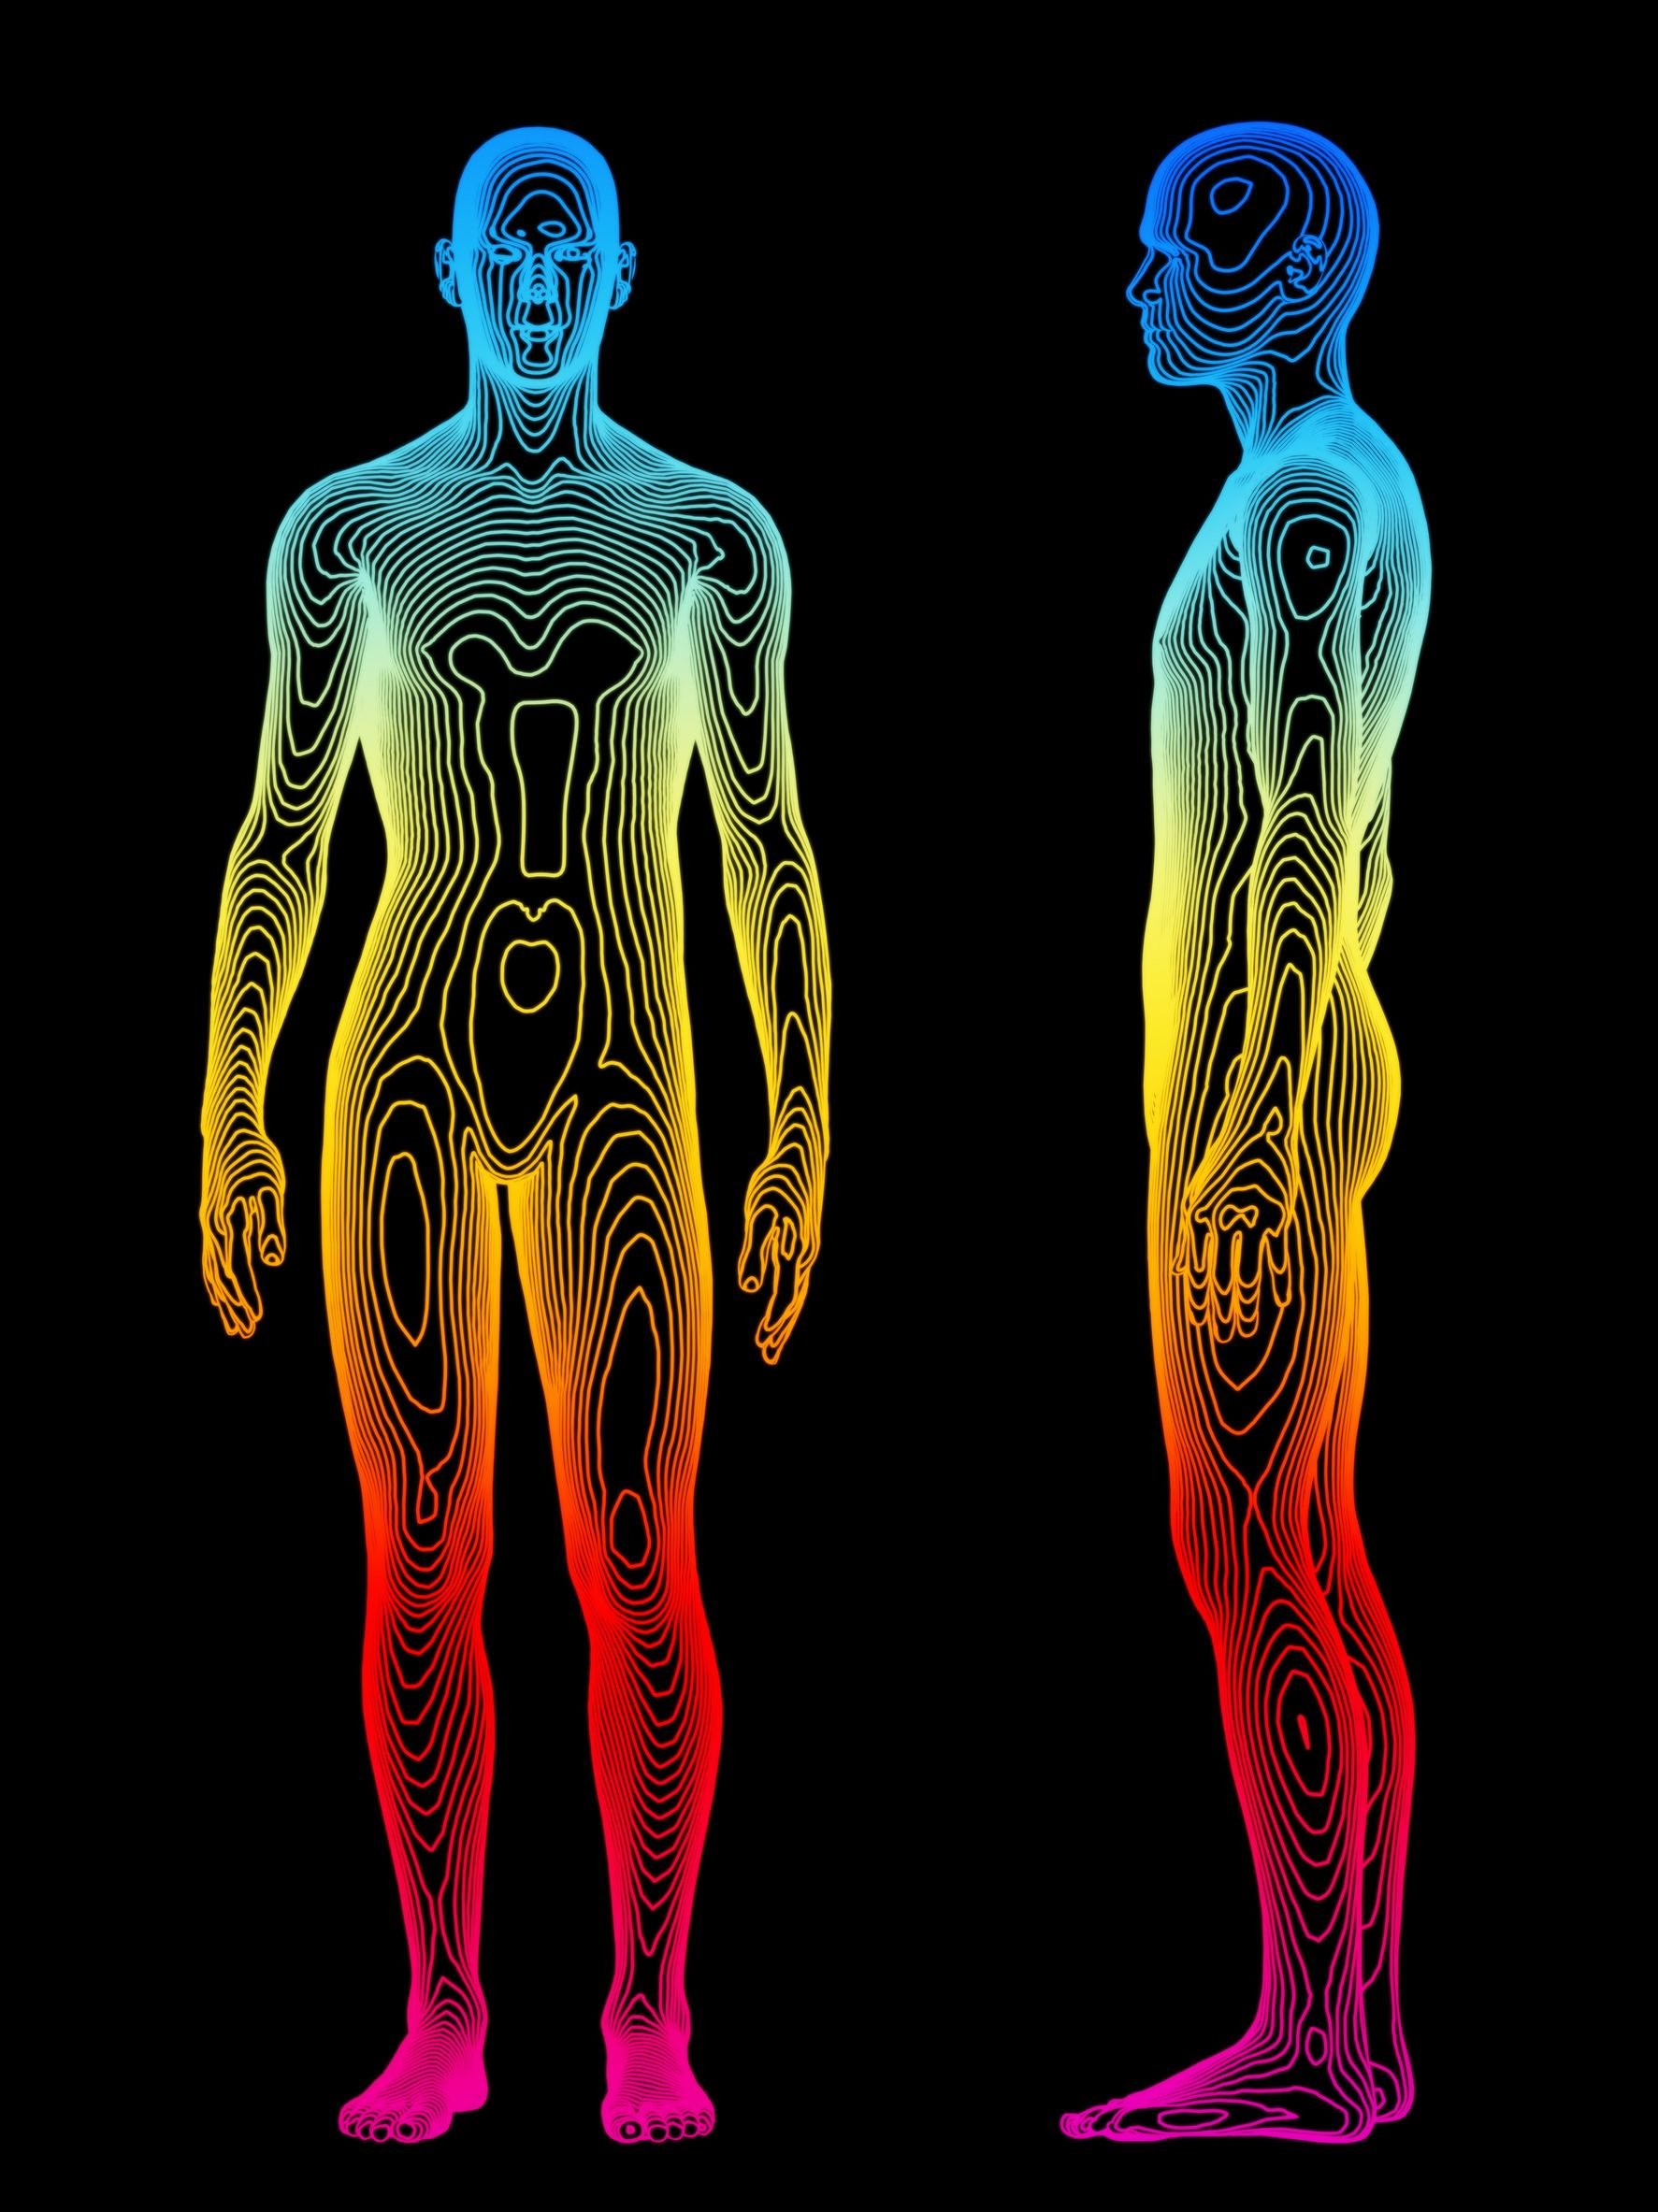
Body scan
start at the top of your head and work your way down. See if you can feel tension in each muscle.

Slide 7
mindfulness
the quality or state of being conscious or aware of something.
a mental state achieved by focusing one's awareness on the present moment, while calmly acknowledging and accepting one's feelings, thoughts, and bodily sensations, used as a therapeutic technique.

Slide 8
What can mindfulness help you do?
Create healthy boundaries
Be present and recognize your emotions and actions
Cope with stress
Connect with others
Deal with clients, family, coworkers, etc.

Slide 9
meditation
Meditation is a precise technique for resting the mind and attaining a state of consciousness that is totally different from the normal waking state. Meditation is not a part of any religion; it is a science, which means that the process of meditation follows a particular order, has definite principles, and produces results that can be verified.
~yogainternational.com

Slide 10
Deep breathing exercise for meditation
We are usually breathing the wrong way!
Typically people breath Short breaths through the chest, which keeps the sympathetic nervous system (SNS) activated
Belly breathing is key!
Belly breathing activates the Parasympathetic nervous system (PNS):
stimulates limbic function (regulating emotions, behavior, motivation, & memory)
lowers cortisol
helps the body to relax
pNS must be activated to heal the body
5 minute exercise

Slide 11
Examples of Alternative therapies for self care
Meditation
Reiki
Essential oils
Massage
Acupuncture
Tai chi
Emotional freedom technique (tapping)
Yoga
Spinal manipulation
Crystal therapy
Sound therapy
Light therapy

Slide 12
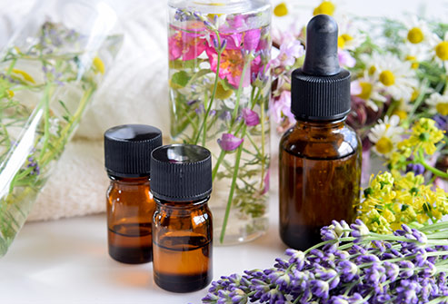
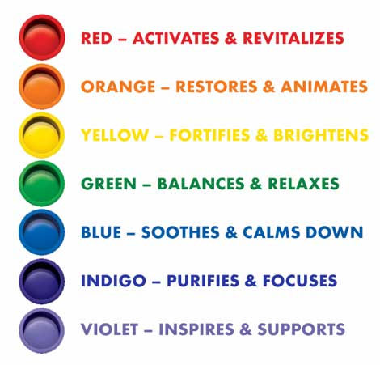
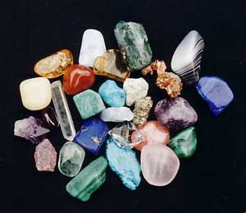
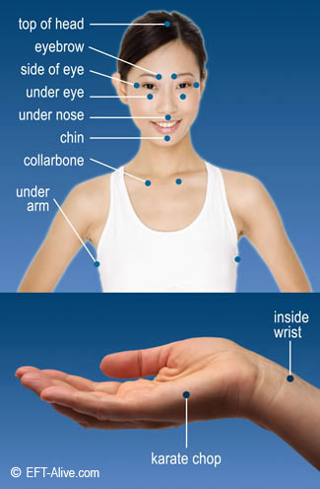
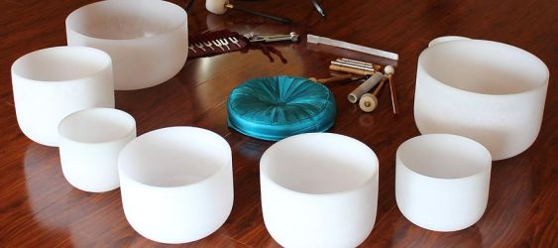
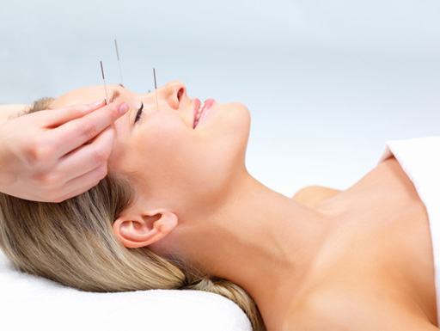

Slide 13
What are Essential oils?

Slide 14
Essential oils
Distilled compounds derived from seeds, stems, bark, roots, flowers, and other parts of plants
Works on the limbic system-(regulate emotions, behavior, motivation, and memory)
Why we associate some memories with smells
When inhaled, essential oils enter the olfactory system and directly affect the amygdala, impacting mood and emotions

Slide 15
REIKI (Pronounced RAY-KEE)
The National Center for Complementary and Alternative Medicine (http://nccam.nih.gov) recognizes Reiki as part of complementary and alternative medicine and places it within a domain called Energy Medicine
Reiki is based on the principle that each of us has unseen life force energy
When energy is out of balance, we feel stressed and are prone to illness
REIki promotes a healing response and restores balance back to the body
excellent tool for self-care
Reiki can be used as a treatment for a wide variety of reasons: STRESS, DEPRESSION, CHRONIC PAIN, RECOVERY FROM SURGERY, LOWERING BLOOD PRESSURE AND HEART RATE, SIDE EFFECTS OF CHEMOTHERAPY, IMPROVING IMMUNITY, MENTAL CLARITY, SENSE OF WELL BEING, SPIRITUALITY, AND PALLIATIVE CARE.

Slide 16
Sound bowls…is this what you expect to see?

Slide 17
Sound bowls
Singing bowls have been used for centuries as a tool for shifting into meditative states and emotional quietude.
The vibrations of the crystal healing bowls have many benefits of healing. The tones produced by the bowls are not just heard by the ear, but also felt in the body affecting the energy centers for healing, balancing and deep meditation.

Slide 18
References
www.Mercola.com
www.Thetappingsolution.com
www.Doterra.com
www.Yogainternational.com
The essential life 4th Edition, Total wellness publishing
National Center for Complementary and Alternative Medicine (http://nccam.nih.gov)
www.naturalforcesstudio.com
www.movieclips.com
www.youtube.com
www.memegenerator.net

